Slide 1
Algorithms & Analysis
A. Levitin “Introduction to the Design & Analysis of Algorithms,” 3rd ed., Ch. 2 ©2012 Pearson Education, Inc. Upper Saddle River, NJ. All Rights Reserved.
1

Slide 2
What is an Algorithm
A step-by-step specification of a method to solve a problem within a finite amount of time
[Alternative] A precise set of rules specifying how to solve a particular problem
1-2

Slide 3
Express Algorithms
High-level:
Assume the first item is largest.
Look at each of the remaining items in the list and if it is larger than the largest item so far, make a note of it.
The last noted item is the largest in the list when the process is complete.
1-3

Slide 4
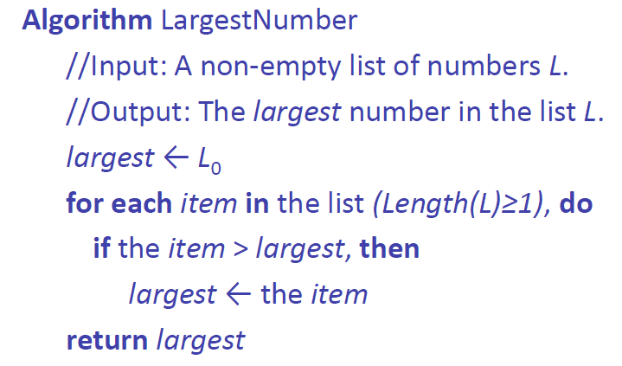
Express Algorithms
Formal -level:
1-4

Slide 5
Express Algorithms
Expressed at a level of abstraction that allows:
A focus on essential aspects only
Machine and language independence
Rigorous scientific/mathematical analysis
1-5

Slide 6
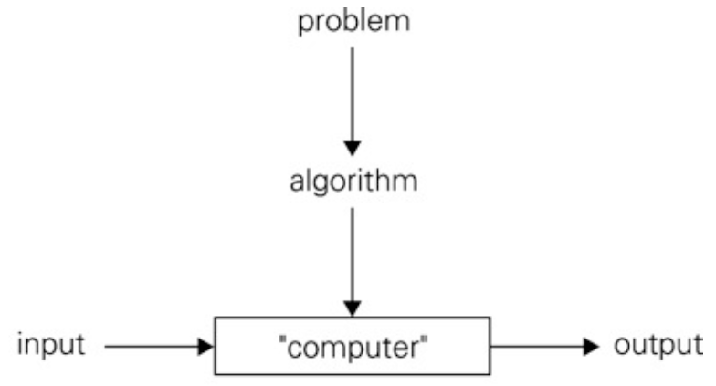
Algorithm: Definition
An Algorithm is a sequence of unambiguous instructions for solving a problem, i.e., for obtaining a required output for any legitimate input in a finite time
1-6

Slide 7
Properties of the definition
Each step must be unambiguous
Range of allowable inputs must be specified
The same algorithm can be represented in different ways
There can be several algorithms for the same problem
They can differ dramatically in concept, speed, and space requirements
1-7
Notes:
7

Slide 8
Common Features
Descriptions of algorithms often involve:
Sequential and Parallel Execution
Conditionals and Decision Making
Looping and Repetition
Assumed Details
etc…
There are corresponding features in many programming languages.
1-8

Slide 9
How Good is an Algorithm?
Given a particular algorithm, we might ask:
Does it solve the original problem?
How fast is it?
How much space does it require?
Are there “better” ways to solve this problem?
1-9

Slide 10
First Approach: Experiment!
Implement the algorithm
Run it on some test data
1-10

Slide 11
First Approach: Experiment!
Implement the algorithm
Run it on some test data
But if we can’t test all possible inputs
We might miss cases where the algorithm fails
We might miss cases where performance is particularly good (or bad)
Results will depend on implementation details
Works well in some, but not all cases?
1-11

Slide 12
Second Approach: Analyze!
Study the algorithm in general terms
Try to predict general trends in behavior
Correctness: Does it do the “right thing”?
Performance:
How long does it take?
How much memory does it use?
1-12

Slide 13
Performance
Execution time depends on:
The size of the input data
The input data itself
The machine and implementation
What exactly do we want to measure?
Clock ticks?
Wall time?
Number of machine instructions?
Number of primitive operations?
All of the above
It doesn’t really matter
1-13

Slide 14
Analysis of algorithms
Example
for i: 0 🡪 n
for j: i 🡪 n
Do something
Number of operations: f(n) = C₁ * n(n+1)/2 ~ C * n²
1-14

Slide 15
Analysis of algorithms
Example
for i: 0 → n
for j: 1 → n
Do something
Number of operations: f(n) = C₁ * n(n+1)/2 ~ C * n²
Example
for i: 0 → n
Do something
Number of operations: g(n) = K * n
1-15

Slide 16
Best-case, average-case, worst-case
For some algorithms efficiency depends on form of input:
Worst case: C_{worst}(n) – maximum over inputs of size n
Best case: C_{best}(n) – minimum over inputs of size n
Average case: C_{avg}(n) – “average” over inputs of size n
Number of times the basic operation will be executed on typical input
NOT the average of worst and best case
Expected number of basic operations considered as a random variable under some assumption about the probability distribution of all possible inputs
A. Levitin “Introduction to the Design & Analysis of Algorithms,” 3rd ed., Ch. 2 ©2012 Pearson Education, Inc. Upper Saddle River, NJ. All Rights Reserved.
16
Notes:
16

Slide 17
Types of formulas for basic operation’s count
Exact formula
e.g., C(n) = n(n-1)/2
Formula indicating order of growth with specific multiplicative constant
e.g., C(n) ≈ 0.5 n²
Formula indicating order of growth with unknown multiplicative constant
e.g., C(n) ≈ cn²
A. Levitin “Introduction to the Design & Analysis of Algorithms,” 3rd ed., Ch. 2 ©2012 Pearson Education, Inc. Upper Saddle River, NJ. All Rights Reserved.
17
Notes:
17

Slide 18
Order of growth
Most important: Order of growth within a constant multiple as n→∞
Example:
How much faster will algorithm run on computer that is twice as fast?
How much longer does it take to solve problem of double input size?
A. Levitin “Introduction to the Design & Analysis of Algorithms,” 3rd ed., Ch. 2 ©2012 Pearson Education, Inc. Upper Saddle River, NJ. All Rights Reserved.
18
Notes:
18
Example: cn²
how much faster on twice as fast computer? (2)
how much longer for 2n? (4)

Slide 19
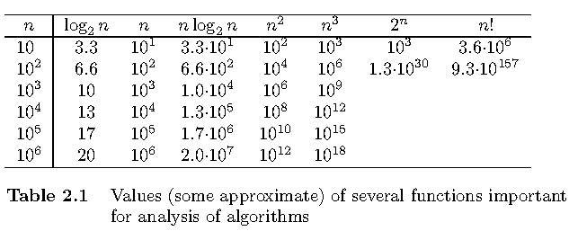
Values of some important functions as n → ∞
A. Levitin “Introduction to the Design & Analysis of Algorithms,” 3rd ed., Ch. 2 ©2012 Pearson Education, Inc. Upper Saddle River, NJ. All Rights Reserved.
19
Notes:
19

Slide 20
Asymptotic order of growth
A way of comparing functions that ignores constant factors and small input sizes
O(g(n)): class of functions f(n) that grow no faster than g(n)
Θ(g(n)): class of functions f(n) that grow at same rate as g(n)
Ω(g(n)): class of functions f(n) that grow at least as fast as g(n)
A. Levitin “Introduction to the Design & Analysis of Algorithms,” 3rd ed., Ch. 2 ©2012 Pearson Education, Inc. Upper Saddle River, NJ. All Rights Reserved.
20
Notes:
20

Slide 21
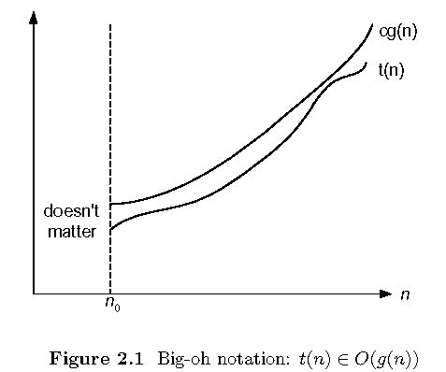
Big-oh
A. Levitin “Introduction to the Design & Analysis of Algorithms,” 3rd ed., Ch. 2 ©2012 Pearson Education, Inc. Upper Saddle River, NJ. All Rights Reserved.
21
Notes:
21

Slide 22
Some properties of asymptotic order of growth
f(n) ∈ O(f(n))
f(n) ∈ O(g(n)) iff g(n) ∈Ω(f(n))
If f (n) ∈ O(g (n)) and g(n) ∈ O(h(n)) , then f(n) ∈ O(h(n)) Note similarity with a ≤ b
If f₁(n) ∈ O(g₁(n)) and f₂(n) ∈ O(g₂(n)) , then
f₁(n) + f₂(n) ∈ O(max{g₁(n), g₂(n)})
A. Levitin “Introduction to the Design & Analysis of Algorithms,” 3rd ed., Ch. 2 ©2012 Pearson Education, Inc. Upper Saddle River, NJ. All Rights Reserved.
22
Notes:
22

Slide 23
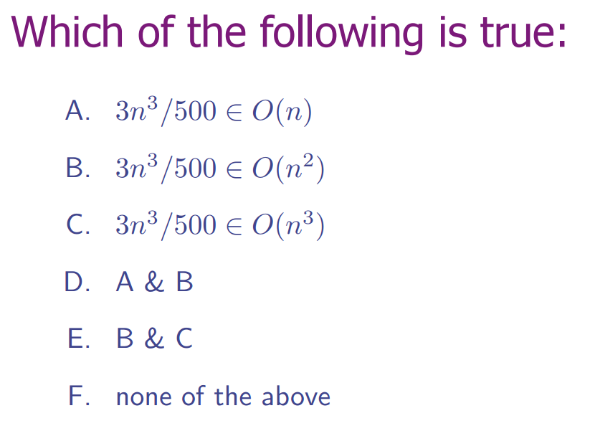
A. Levitin “Introduction to the Design & Analysis of Algorithms,” 3rd ed., Ch. 2 ©2012 Pearson Education, Inc. Upper Saddle River, NJ. All Rights Reserved.
23

Slide 24
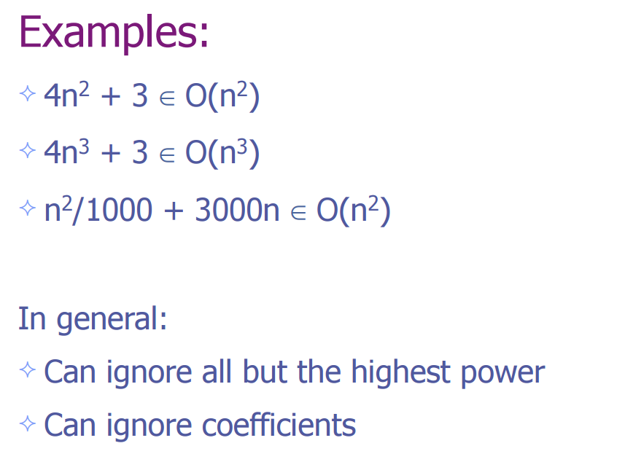
A. Levitin “Introduction to the Design & Analysis of Algorithms,” 3rd ed., Ch. 2 ©2012 Pearson Education, Inc. Upper Saddle River, NJ. All Rights Reserved.
24

Slide 25
Establishing order of growth using limits
0 order of growth of T(n) < order of growth of g(n)
lim T(n)/g(n) =
c > 0 order of growth of T(n) = order of growth of g(n)
n→∞
∞ order of growth of T(n) > order of growth of g(n)
Examples:
10n vs. n² n(n+1)/2 vs. n²
a^{n} vs. b^{n}
2^{n} vs. n!
A. Levitin “Introduction to the Design & Analysis of Algorithms,” 3rd ed., Ch. 2 ©2012 Pearson Education, Inc. Upper Saddle River, NJ. All Rights Reserved.
25
Notes:
25

Slide 26
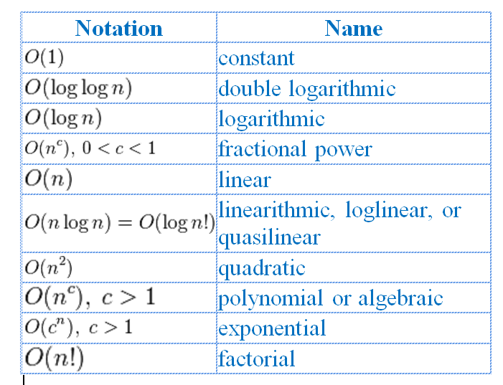
Basic asymptotic efficiency classes
1 | constant
log n | logarithmic
n | linear
n log n | n-log-n or linearithmic
n² | quadratic
n³ | cubic
2^{n} | exponential
n! | factorial
A. Levitin “Introduction to the Design & Analysis of Algorithms,” 3rd ed., Ch. 2 ©2012 Pearson Education, Inc. Upper Saddle River, NJ. All Rights Reserved.
26
Notes:
26

Slide 27
Useful summation formulas and rules
Σ_{l≤i≤u}1 = 1+1+ ⋯ +1 = u - l + 1
In particular, Σ_{l≤i≤u}1 = n - 1 + 1 = n ∈ Θ(n)
Σ_{1≤i≤n} i = 1+2+ ⋯ +n = n(n+1)/2 ≈ n²/2 ∈ Θ(n²)
Σ_{1≤i≤n} i² = 1²+2²+ ⋯ +n² = n(n+1)(2n+1)/6 ≈ n³/3 ∈ Θ(n³)
Σ_{0≤i≤n} a^{i} = 1 + a + ⋯ + a^{n} = (a^{n+1} - 1)/(a - 1) for any a ≠ 1
In particular, Σ_{0≤i≤n} 2^{i} = 2⁰ + 2¹ + ⋯ + 2^{n} = 2^{n+1} - 1 ∈ Θ(2^{n} )
Σ(a_{i} ± b_{i} ) = Σa_{i} ± Σb_{i} Σca_{i} = cΣa_{i} Σ_{l≤i≤u}a_{i} = Σ_{l≤i≤m}a_{i} + Σ_{m+1≤i≤u}a_{i}
A. Levitin “Introduction to the Design & Analysis of Algorithms,” 3rd ed., Ch. 2 ©2012 Pearson Education, Inc. Upper Saddle River, NJ. All Rights Reserved.
27
Notes:
27

Slide 28
Recursion
Recursion in computer science is a method where the solution to a problem depends on solutions to smaller instances of the same problem (Wiki).
Folder has subfolders
GCD
Hanoi Towers
Binary Search
Quick Sort
…

Slide 29
Recursive algorithm
A recursive algorithm is an algorithm which calls itself with "smaller (or simpler)" input values, and which obtains the result for the current input by applying simple operations to the returned value for the smaller (or simpler) input.

Slide 30
Plan for Analysis of Recursive Algorithms
Decide on a parameter indicating an input’s size.
Identify the algorithm’s basic operation.
Check whether the number of times the basic op. is executed may vary on different inputs of the same size. (If it may, the worst, average, and best cases must be investigated separately.)
Set up a recurrence relation with an appropriate initial condition expressing the number of times the basic op. is executed.
Solve the recurrence (or, at the very least, establish its solution’s order of growth) by backward substitutions or another method.
A. Levitin “Introduction to the Design & Analysis of Algorithms,” 3rd ed., Ch. 2 ©2012 Pearson Education, Inc. Upper Saddle River, NJ. All Rights Reserved.
30
Notes:
30

